Slide 1





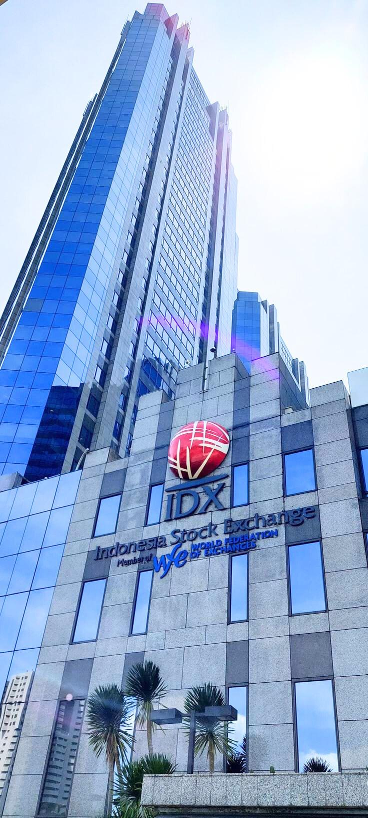

StockPred: Stock Price Prediction Application
Selected Themes/Case:
Economics Empowerment: Navigating Sustainable Economies for All
Presentation 2024
Presented By:
C242-PS012

Slide 2


Disclaimer
All stocks discussed in this presentation are not intended as an invitation to buy or sell specific stocks.
Do Your Own Research (DYOR).
This statement complies with regulations from the Financial Services Authority (Otoritas Jasa Keuangan - OJK) and the Indonesia Stock Exchange (Bursa Efek Indonesia - IDX), which emphasize the importance of independent analysis and informed decision-making in stock investments.

Slide 3



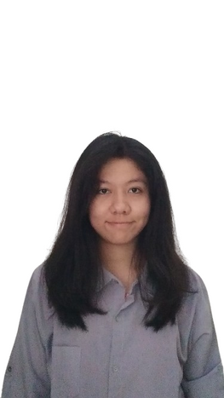



Team Member
Machine Learning (ML)
Achmad Zahir Wajdi
M123B4KY0062
Machine Learning (ML)
Muhammad Rakha Almasah
M007B4KY3020
Machine Learning (ML)
Muhammad Sulthon Haqiqi
M296B4KY3091
Cloud Computing (CC)
Grace Loreta Sianipar
C172B4KX1642
Cloud Computing (CC)
Esi Butarbutar
C172B4KX1291
Mobile Development (MD)
Alvian Rofius Salam
A284B4KY0421
Mobile Development (MD)
Candra Bagus Ainur Rochman
A284B4KY0895

Slide 4
Outline
Problem Statement & Solution
Technology Overview
Implementation Visualization
Video Demo
Impact Result
Documentation
Plan a local deployment on your project

Slide 5

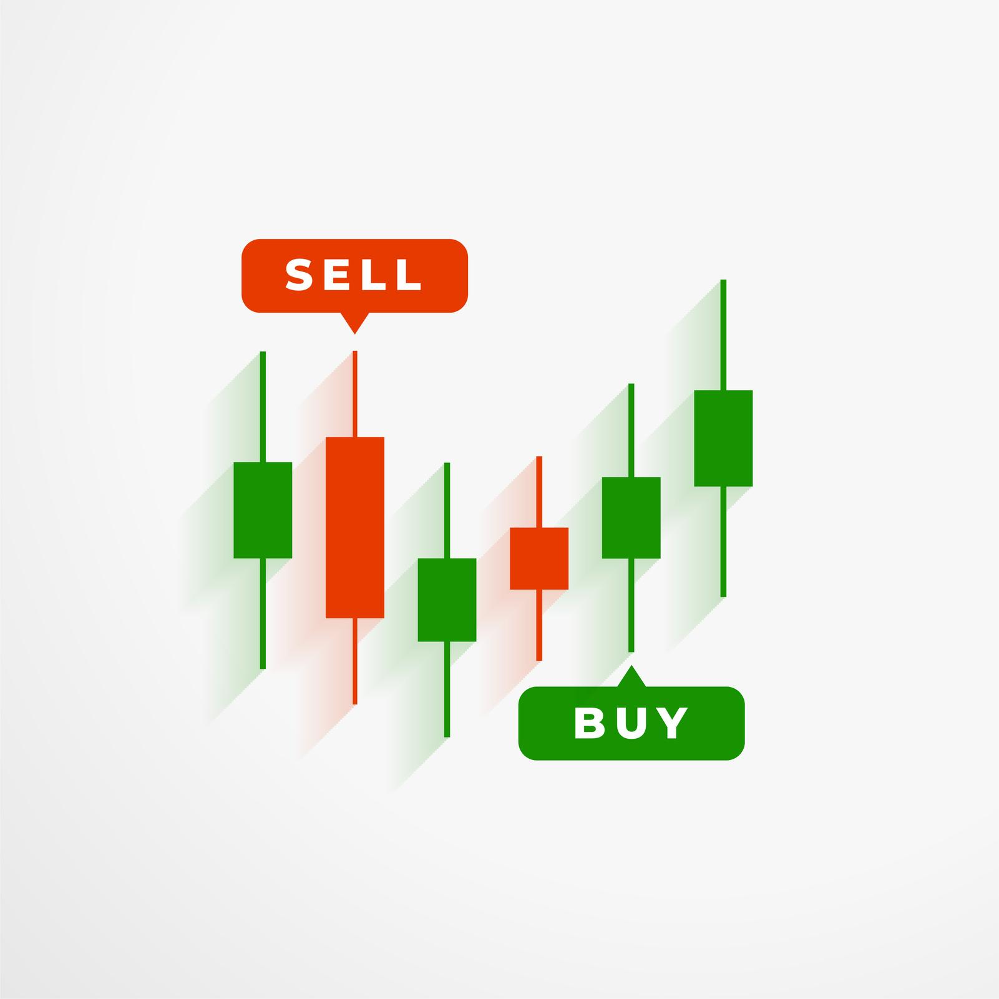
Problem Statement & Solution
Sub Outline :
Number of Stock Investors and Stock Investment Risks
Overview of IHSG
Factors Influencing IHSG Fluctuations
Why Is This Research Important?

Slide 6
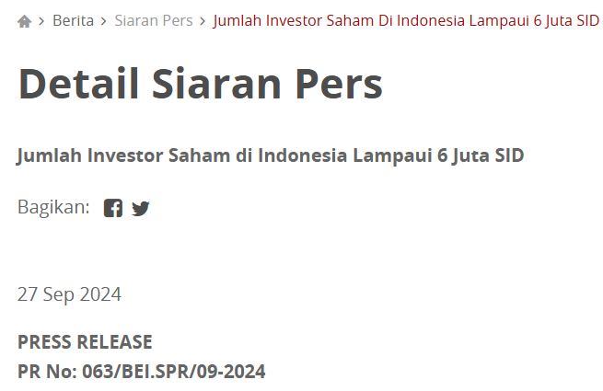
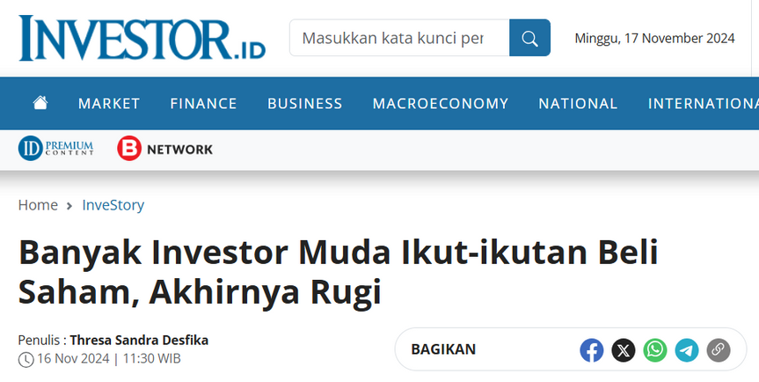
Number of Stock Investors and Stock Investment Risks
As of now, the number of stock investors in Indonesia has reached 6,001,573 Single Investor Identifications (SID).
The Indonesia Stock Exchange (IDX) recorded an increase of over 744,000 new stock investors throughout 2024.
Stocks are considered a high-risk investment instrument due to stock price fluctuations.
Without sufficient knowledge to analyze a stock, investors may face losses.
So, what are the factors that cause stock price fluctuations?

Slide 7
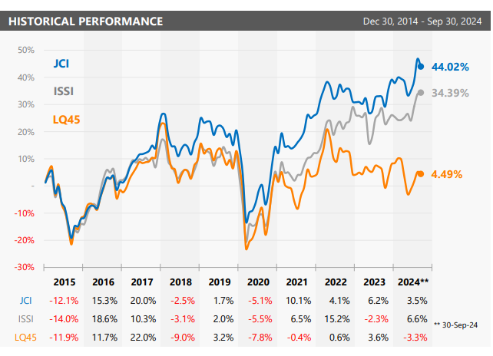
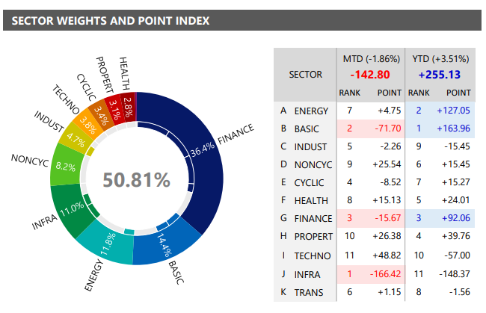
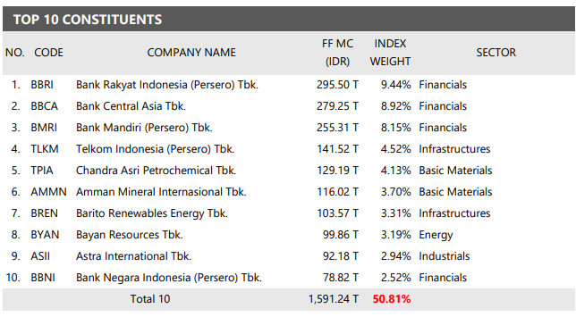
Overview of IHSG
IHSG : An index that measures the stock price performance of all listed companies in Main Board and Development Board of the Indonesia Stock Exchange

Slide 8
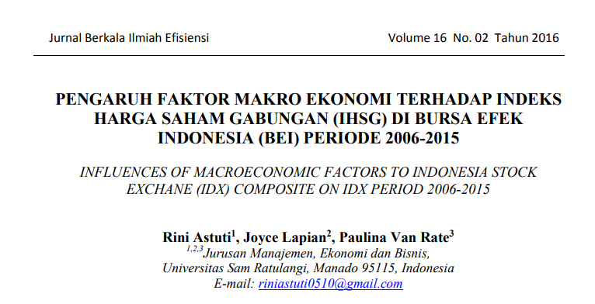
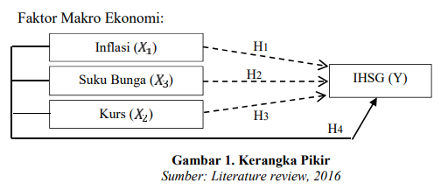
Factors Influencing IHSG Fluctuations
Based on a study conducted by Rini Astuti et al.:
Macroeconomic factors (USD/IDR Exchange Rate, Bank Indonesia Interest Rate, and Inflation Rate)
Simultaneously have a significant impact on the IHSG.
Thus, how can investors predict the price of individual stocks (not the IHSG value) to determine the optimal buy or sell price?

Slide 9

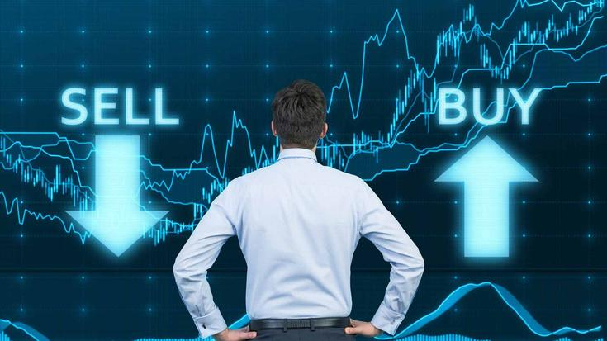
Why Is This Research Important?
Financial Freedom
The ability to meet life’s needs without financial concerns.
Achievable through investment.
Stocks as an Investment Instrument
High potential returns but accompanied by high risks.
Stock price fluctuations often lead to investor losses.
Main Problem
Investors often struggle to analyze the best timing for buying or selling stocks.
The risk of loss increases without adequate analytical skills.

Slide 10

Why Is This Research Important?
Proposed Solution
A technology-based application to accurately predict stock prices.
Assists investors in making informed decisions for buy and sell actions.
Research Benefits
Reduces the risk of losses in stock investments.
Increases the potential for profits.
Helps investors achieve financial freedom.

Slide 11

Technology Overview
Sub Outline :
About StockPred Application
Machine Learning Implementation
Cloud Computing Implementation
Mobile Development Implementation
Cross-Platform Development Implementation

Slide 12




About StockPred Application
StockPred is an application for predicting the prices of 20 stocks listed on the Indonesia Stock Exchange, leveraging four technologies: Machine Learning, Cloud Computing, Mobile Development, and Cross-Platform Development.
Implementation/Enhancement of previous research (Rini Astuti et al.):
Replacing the Dependent Variable (Y) from the IHSG (Jakarta Composite Index) to Individual Stocks.
Using a monthly dataset spanning from 2005 to 2023.
Employing machine learning technology with deep neural networks (DNN) to develop a linear regression model.
The research results are implemented into an Android and Windows based application, making it easier for investors to predict stock prices.
The reason for this implementation/enhancement is to allow investors to directly use this application to determine when to buy or sell a stock.

Slide 13





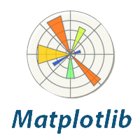

Machine Learning - Tools

Slide 14
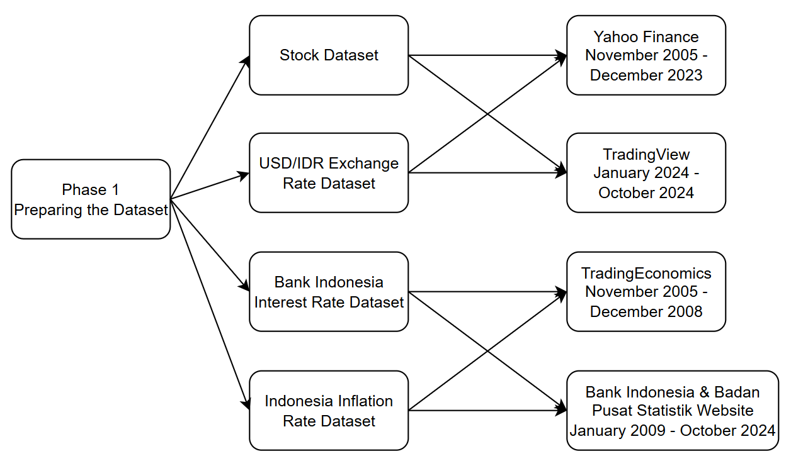
Machine Learning - Phase 1
Preparing the Dataset

Slide 15
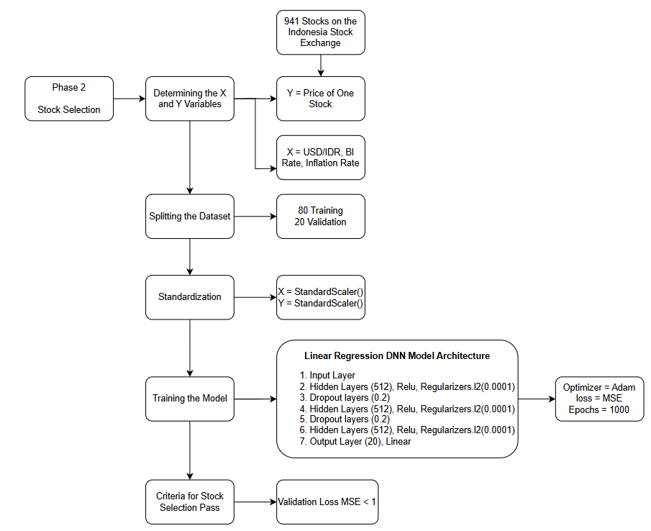
Machine Learning - Phase 2
Stock Selection
1

Slide 16


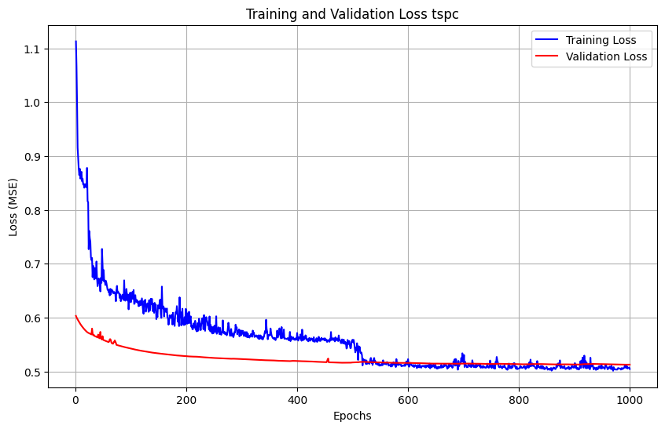
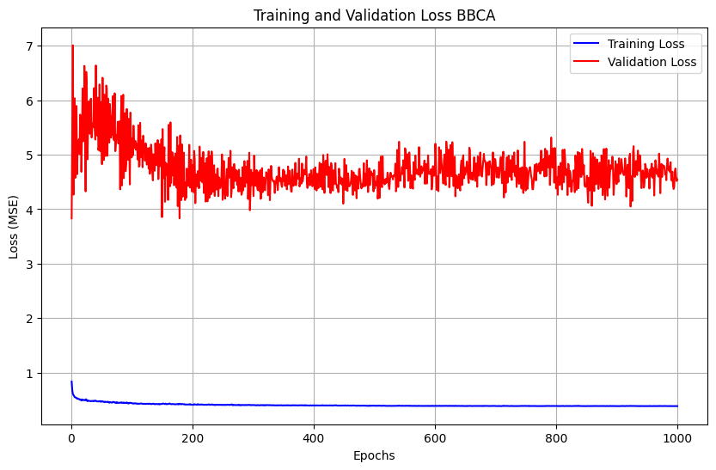
Machine Learning - Phase 2
Stock Selection
Example of Selected Stock:
Tempo Scan Pacific Tbk
Example of Unselected Stock:
PT Bank Central Asia Tbk

Slide 17




















Machine Learning - Phase 2
Stock Selection
20 Selected Stocks Based on Validation Loss MSE ≤ 1

Slide 18
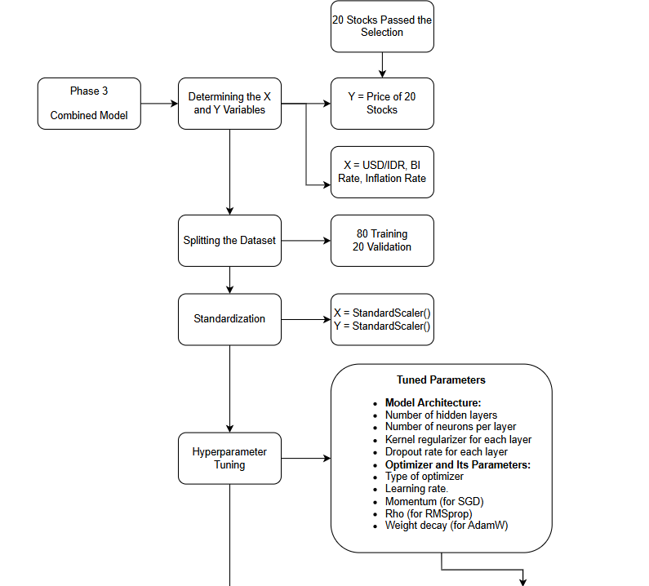
Machine Learning - Phase 3
Combined Model

Slide 19
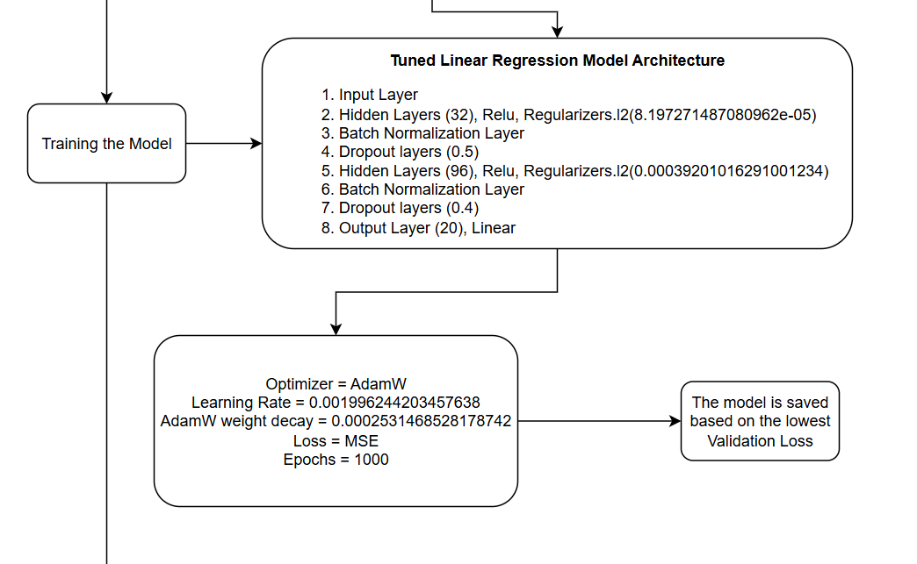
Machine Learning - Phase 3
Combined Model

Slide 20
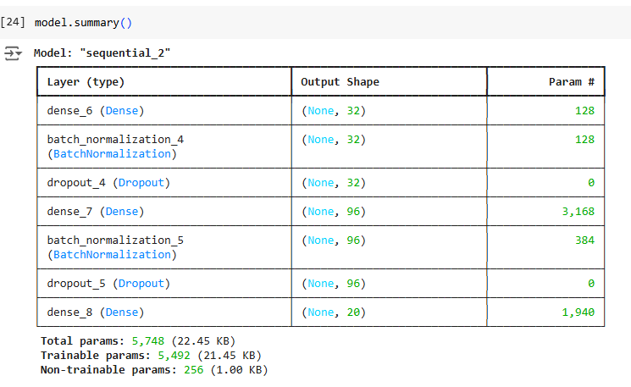
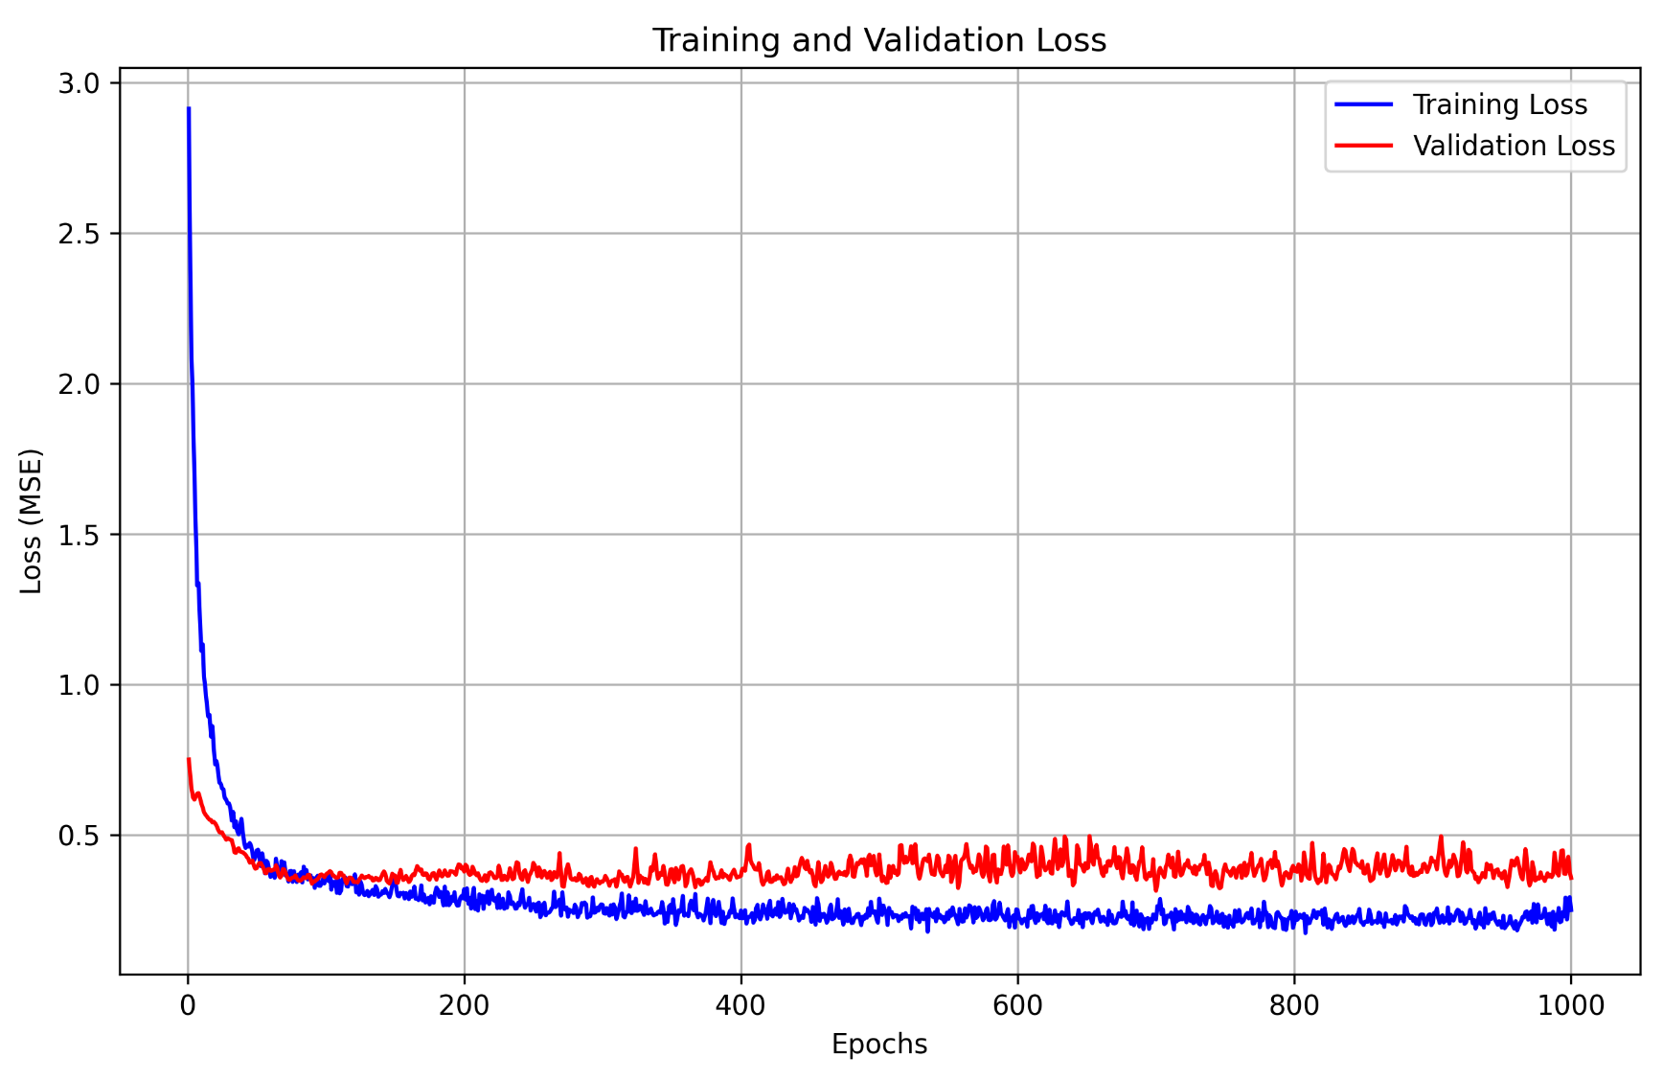
Machine Learning - Phase 3
Combined Model
Model Summary
Model Training Results

Slide 21
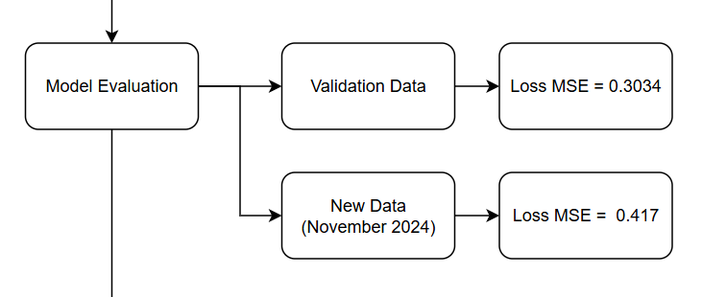
Machine Learning - Phase 3
Combined Model

Slide 22
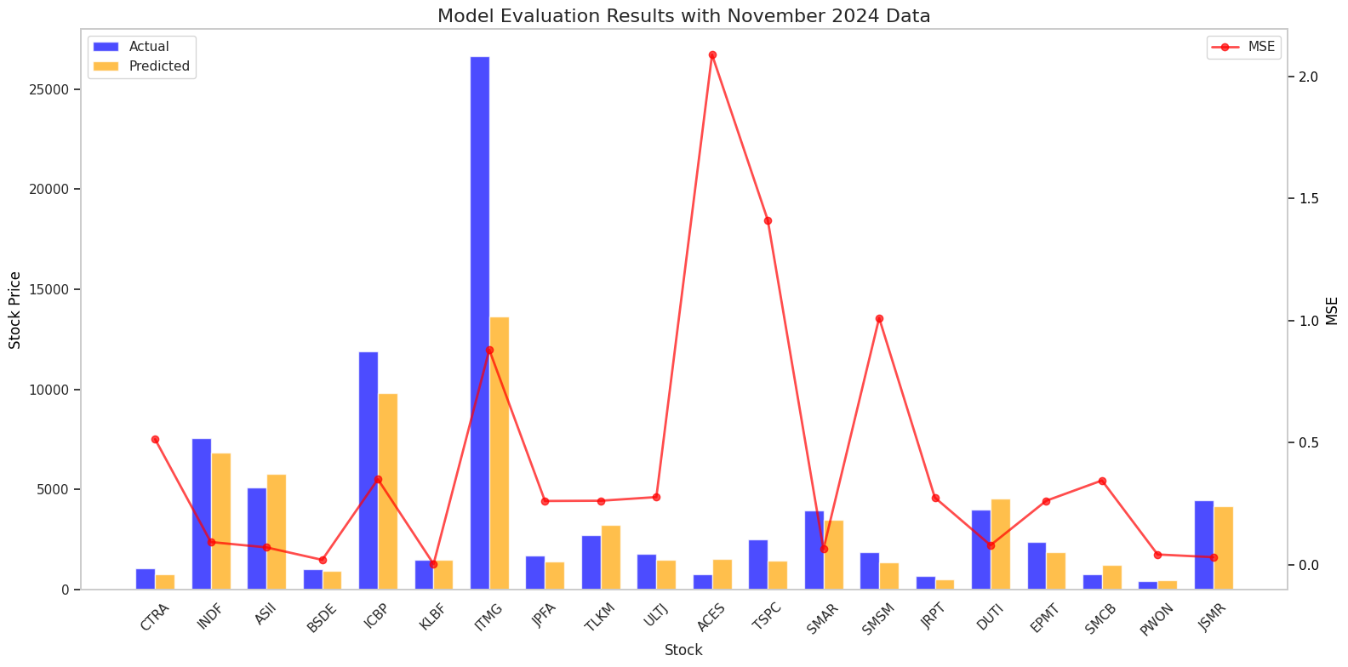
Machine Learning - Phase 3
Combined Model
November 2024 Economic Indicators :
Inflation Rate: 1.55%
BI Rate: 6.00%
USD/IDR Average Closing: 15,834
Stock Data Source: TradingView

Slide 23
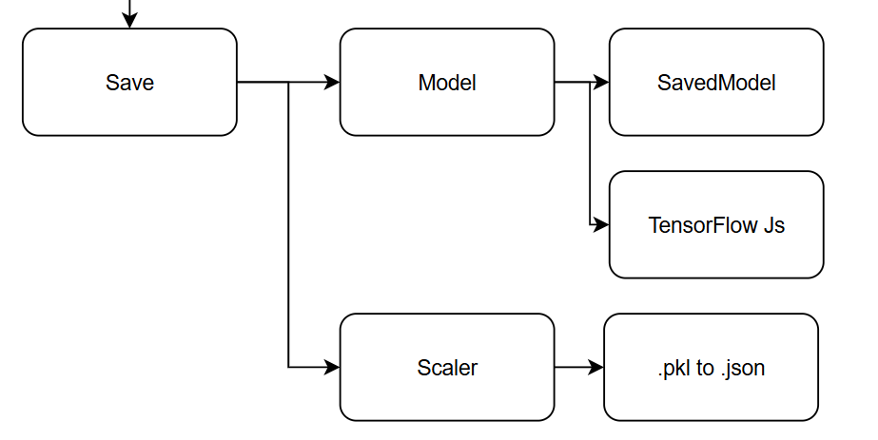
Machine Learning - Phase 3
Combined Model

Slide 24
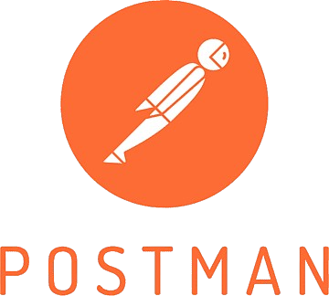
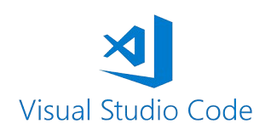
Cloud Computing - Tools

Slide 25

Cloud Computing - Architecture
Cloud Run
A serverless platform for running containerized applications
Cloud IAM
Manage authentication and authorization, ensuring that only users and systems with the appropriate credentials can access the API
Cloud Storage
Storing machine learning models in SavedModel and TensorFlow.js formats

Slide 26
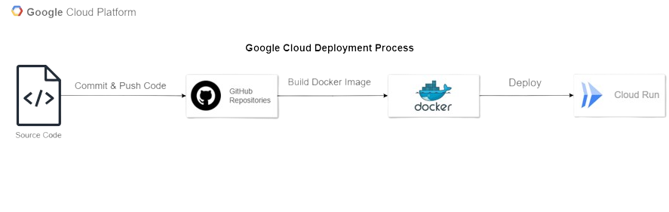
Cloud Computing - Deployment Process

Slide 27
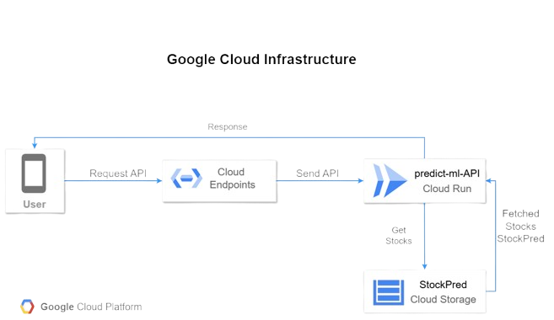
Cloud Computing - Infrastructure

Slide 28

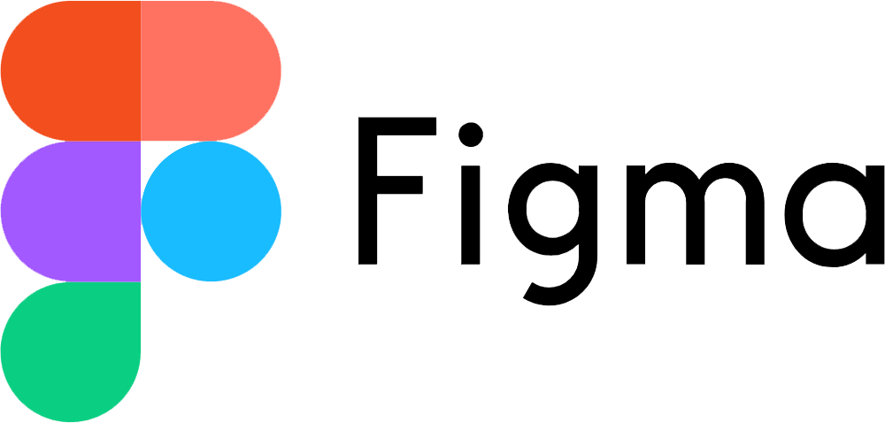

Mobile Development Tools

Slide 29
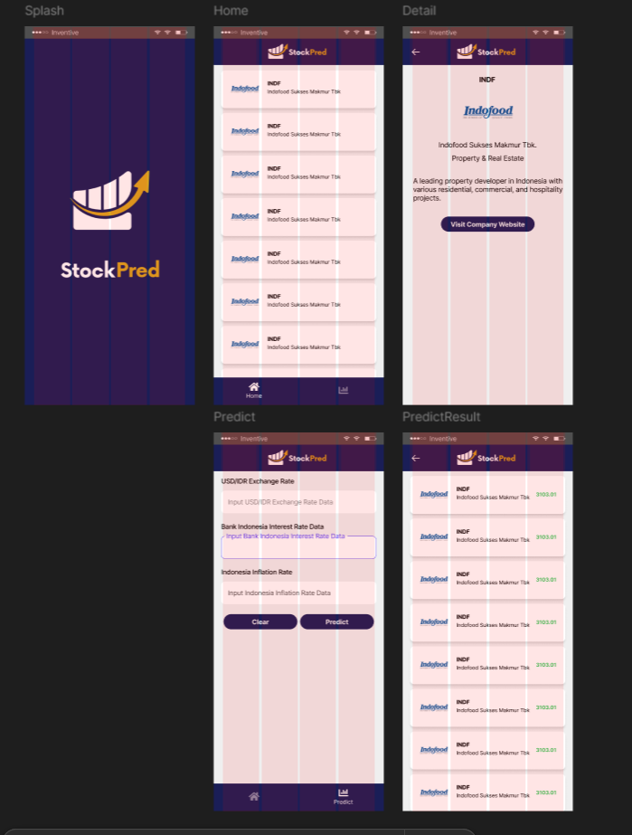
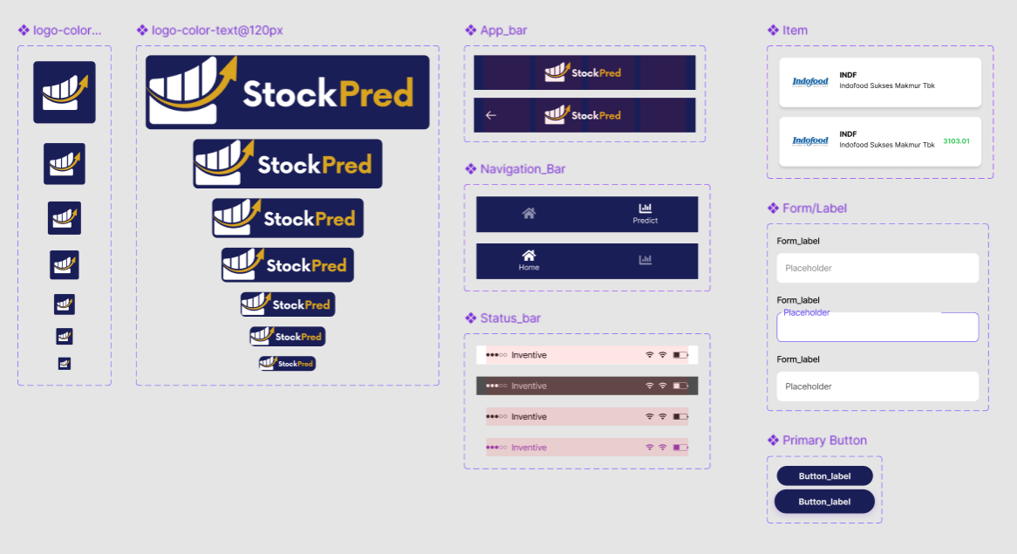
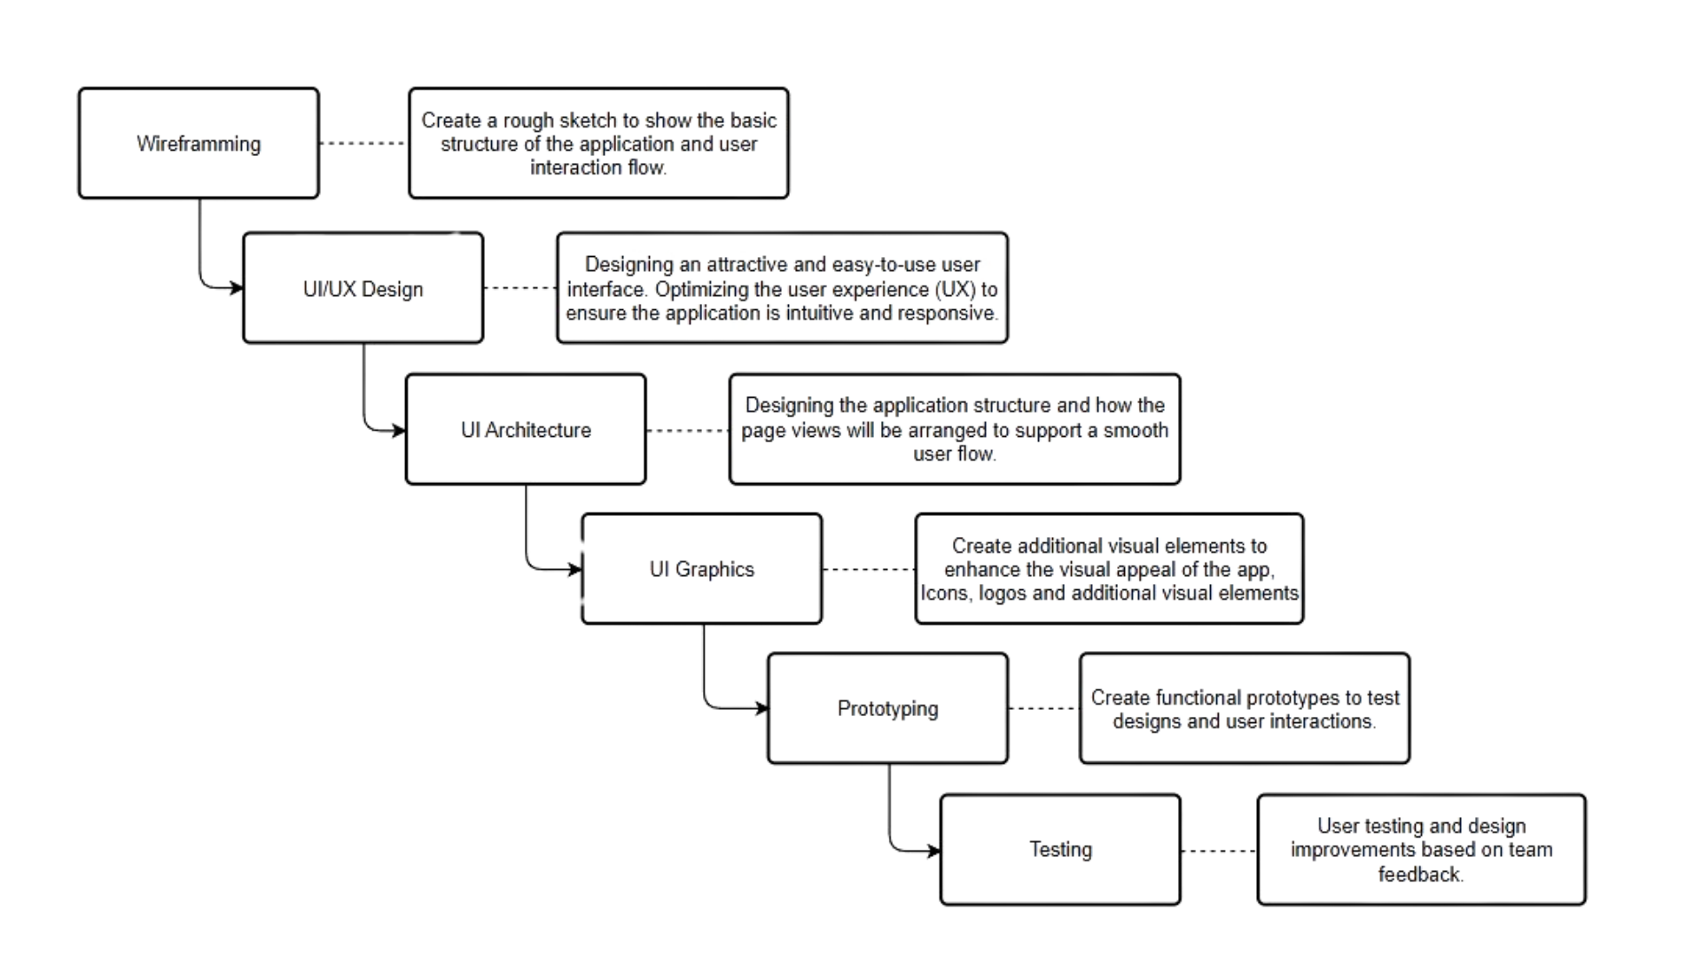
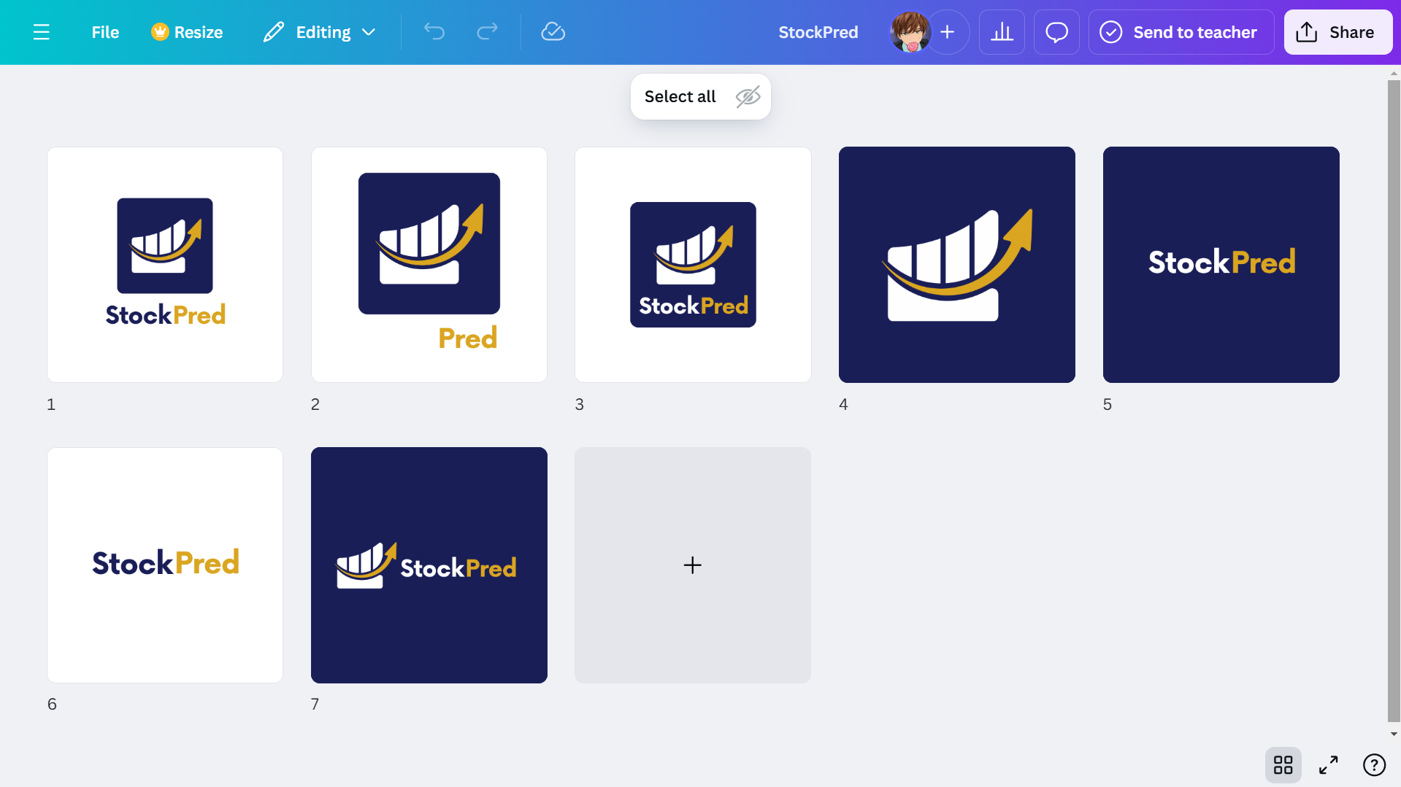
Mobile Development
Designing with Figma & Canva

Slide 30
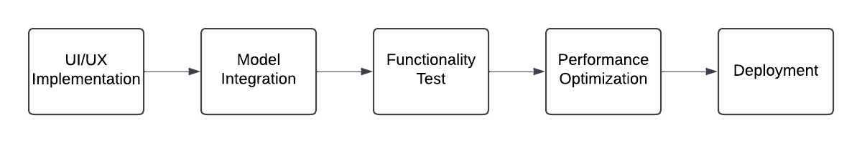
Mobile Development
Workflow

Slide 31


Cross-Platform Development
Cross-Platform Support
Besides being available on Android developed with Kotlin,
StockPred is also available on the Windows platform,
built using the Flutter framework.

Slide 32
Implementation Visualization
Sub Outline :
User Flow
Screenshots Android Application with Kotlin
Screenshots Windows Application with Flutter

Slide 33
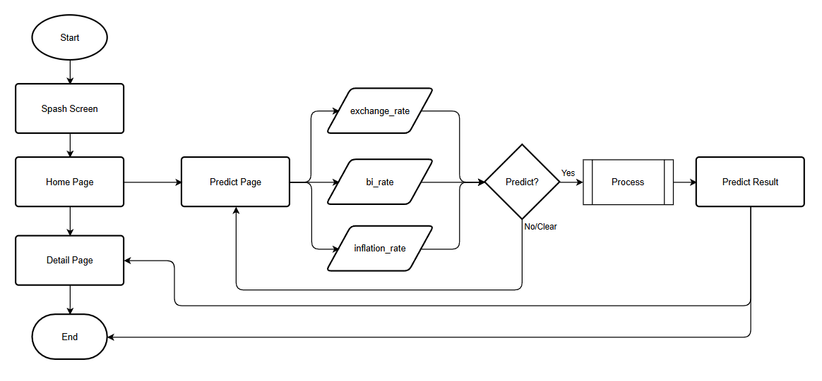
User Flow

Slide 34
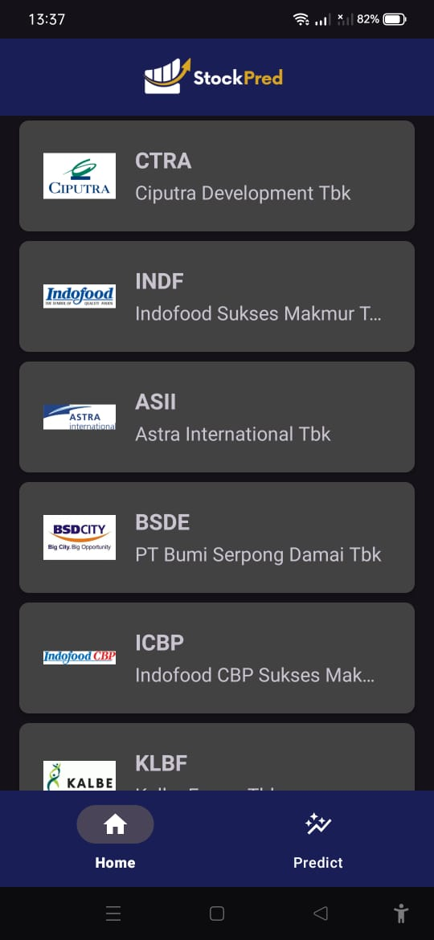
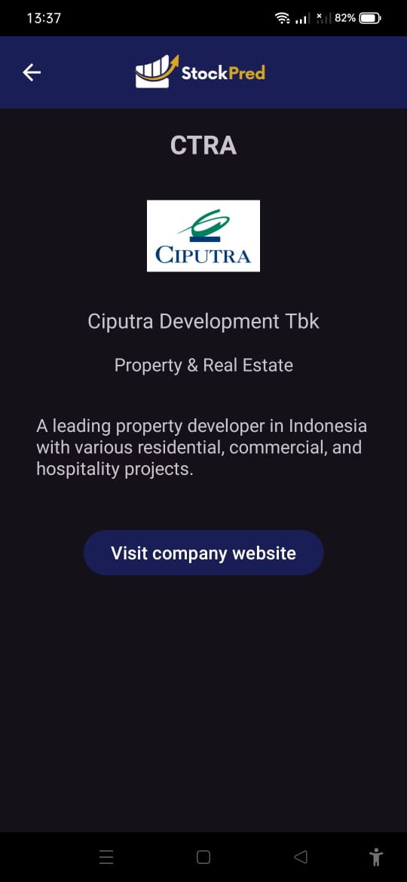
Android Application with Kotlin
Home Menu
Stock Details

Slide 35
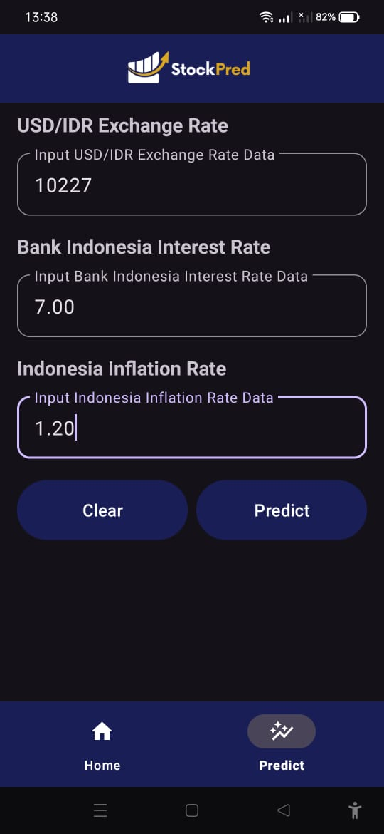
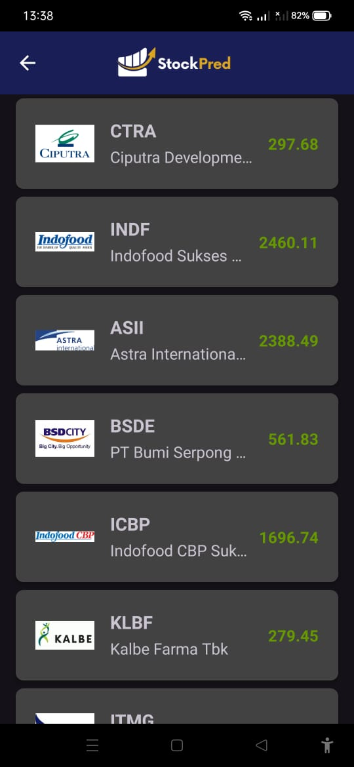
Android Application with Kotlin
Predict Menu
Predict Result

Slide 36
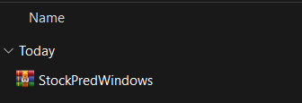
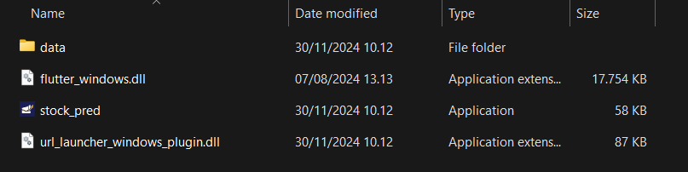
Windows Application with Flutter
How to use the Windows version of the application?
Extract the RAR file StockPredWindows.rar
Click on stock_pred.exe

Slide 37
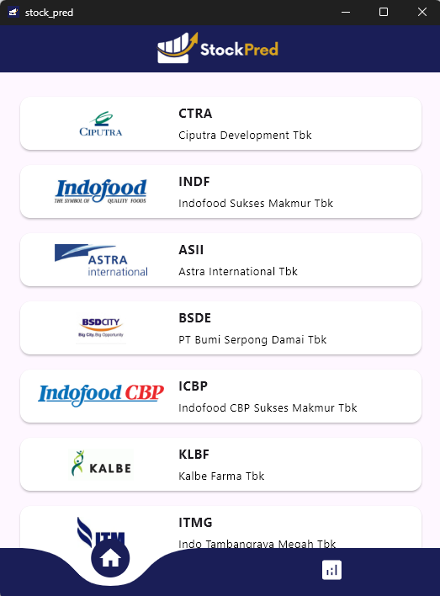
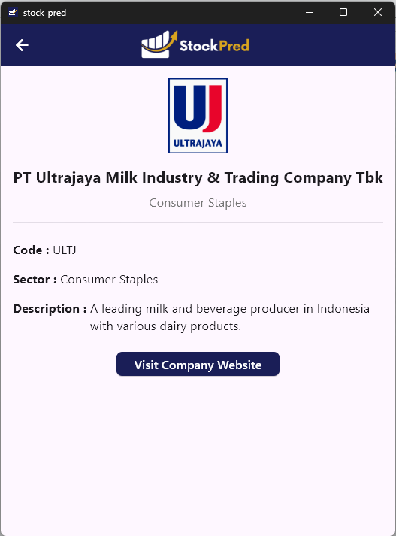
Windows Application with Flutter
Home Menu
Stock Information Details

Slide 38
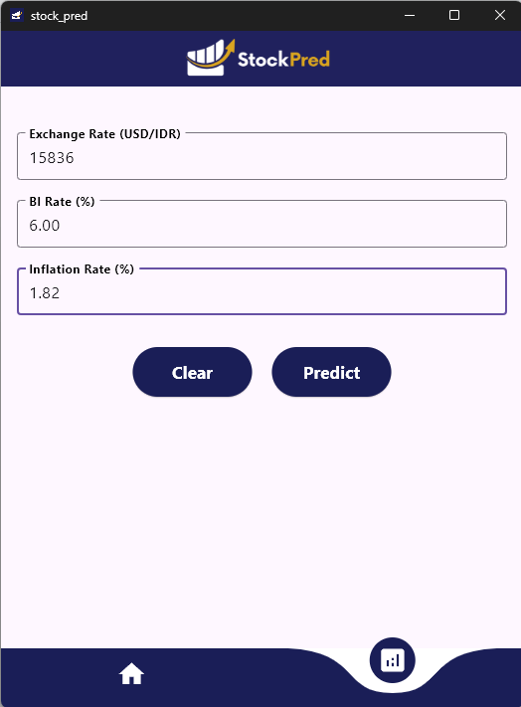
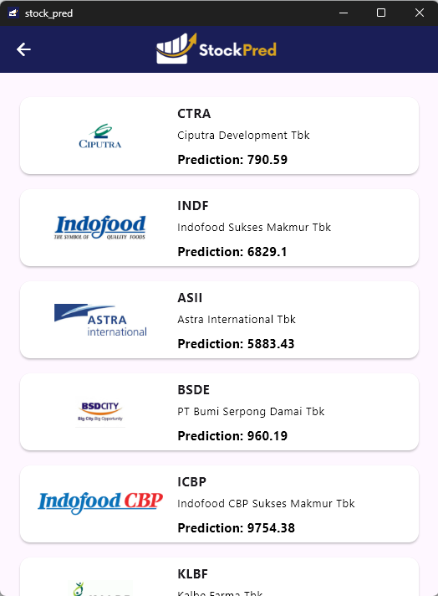
Windows Application with Flutter
Predict Menu
Prediction Results

Slide 39
Video Demo
Sub Outline :
Android Application with Kotlin - Demo App
Windows Application with Flutter - Demo App
Download App

Slide 40
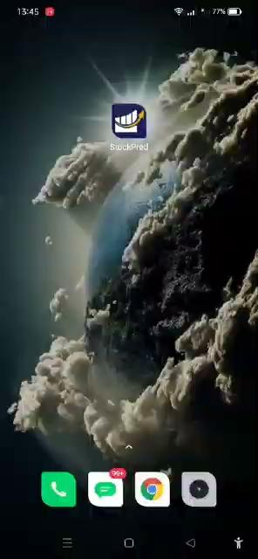
Android Application with Kotlin
Demo App

Slide 41
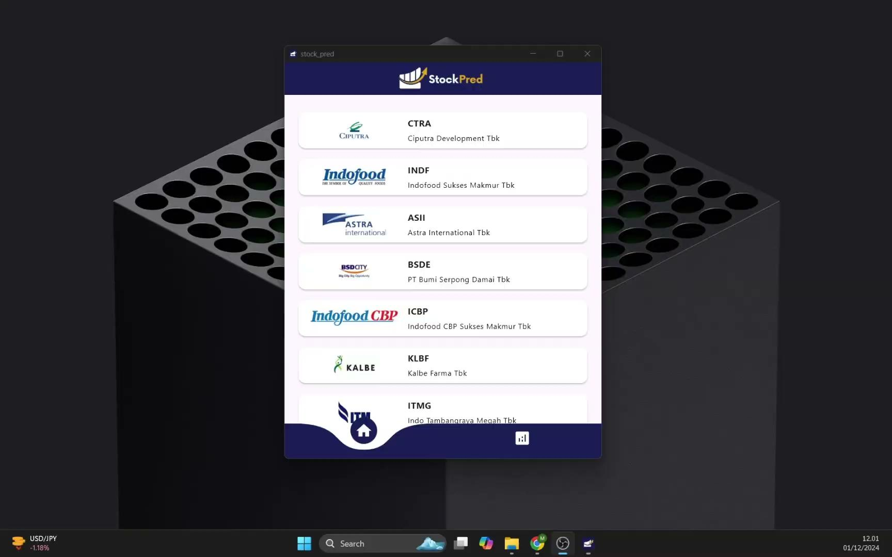
Windows Application with Flutter
Demo App

Slide 42
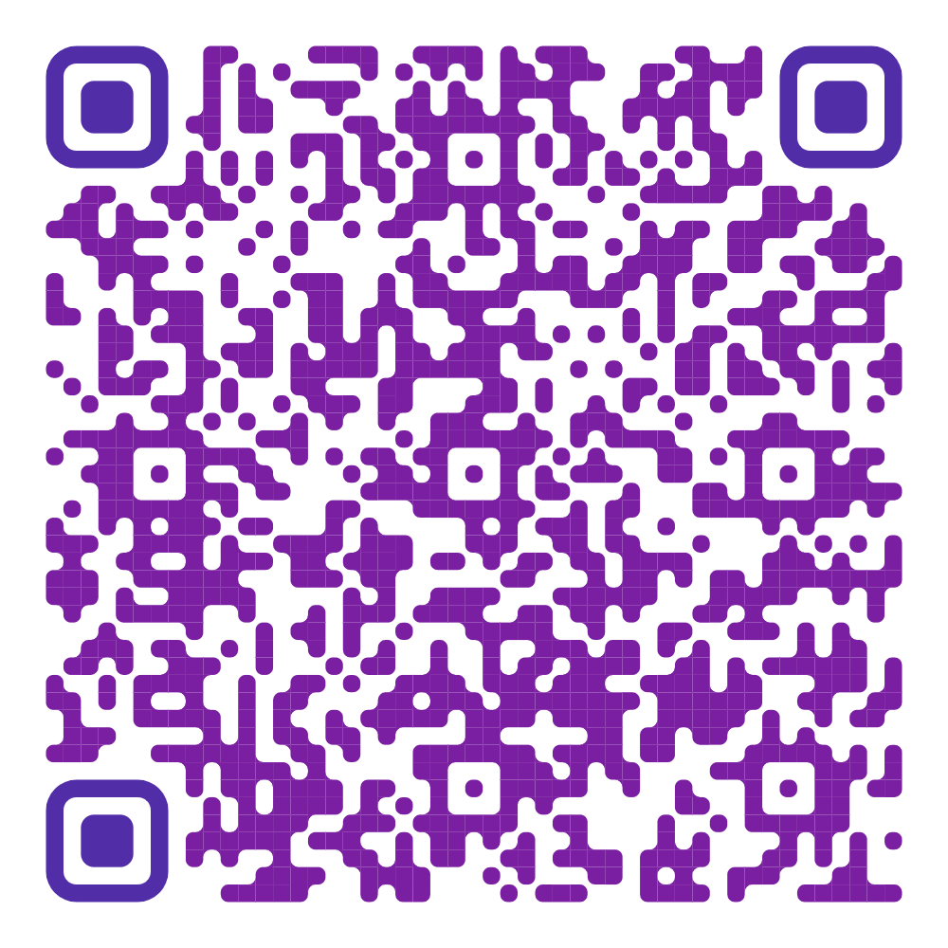
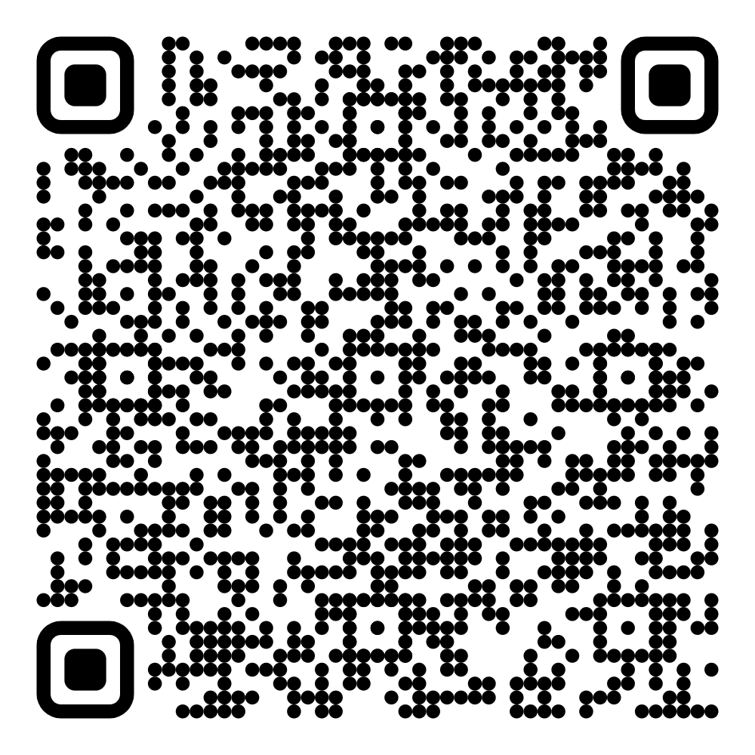
Download Application
Scan Here
https://storage.googleapis.com/stockpredbangkit22024/StockPredAndroid.apk
https://storage.googleapis.com/stockpredbangkit22024/StockPredWindows.rar

Slide 43
Impact Result

Slide 44
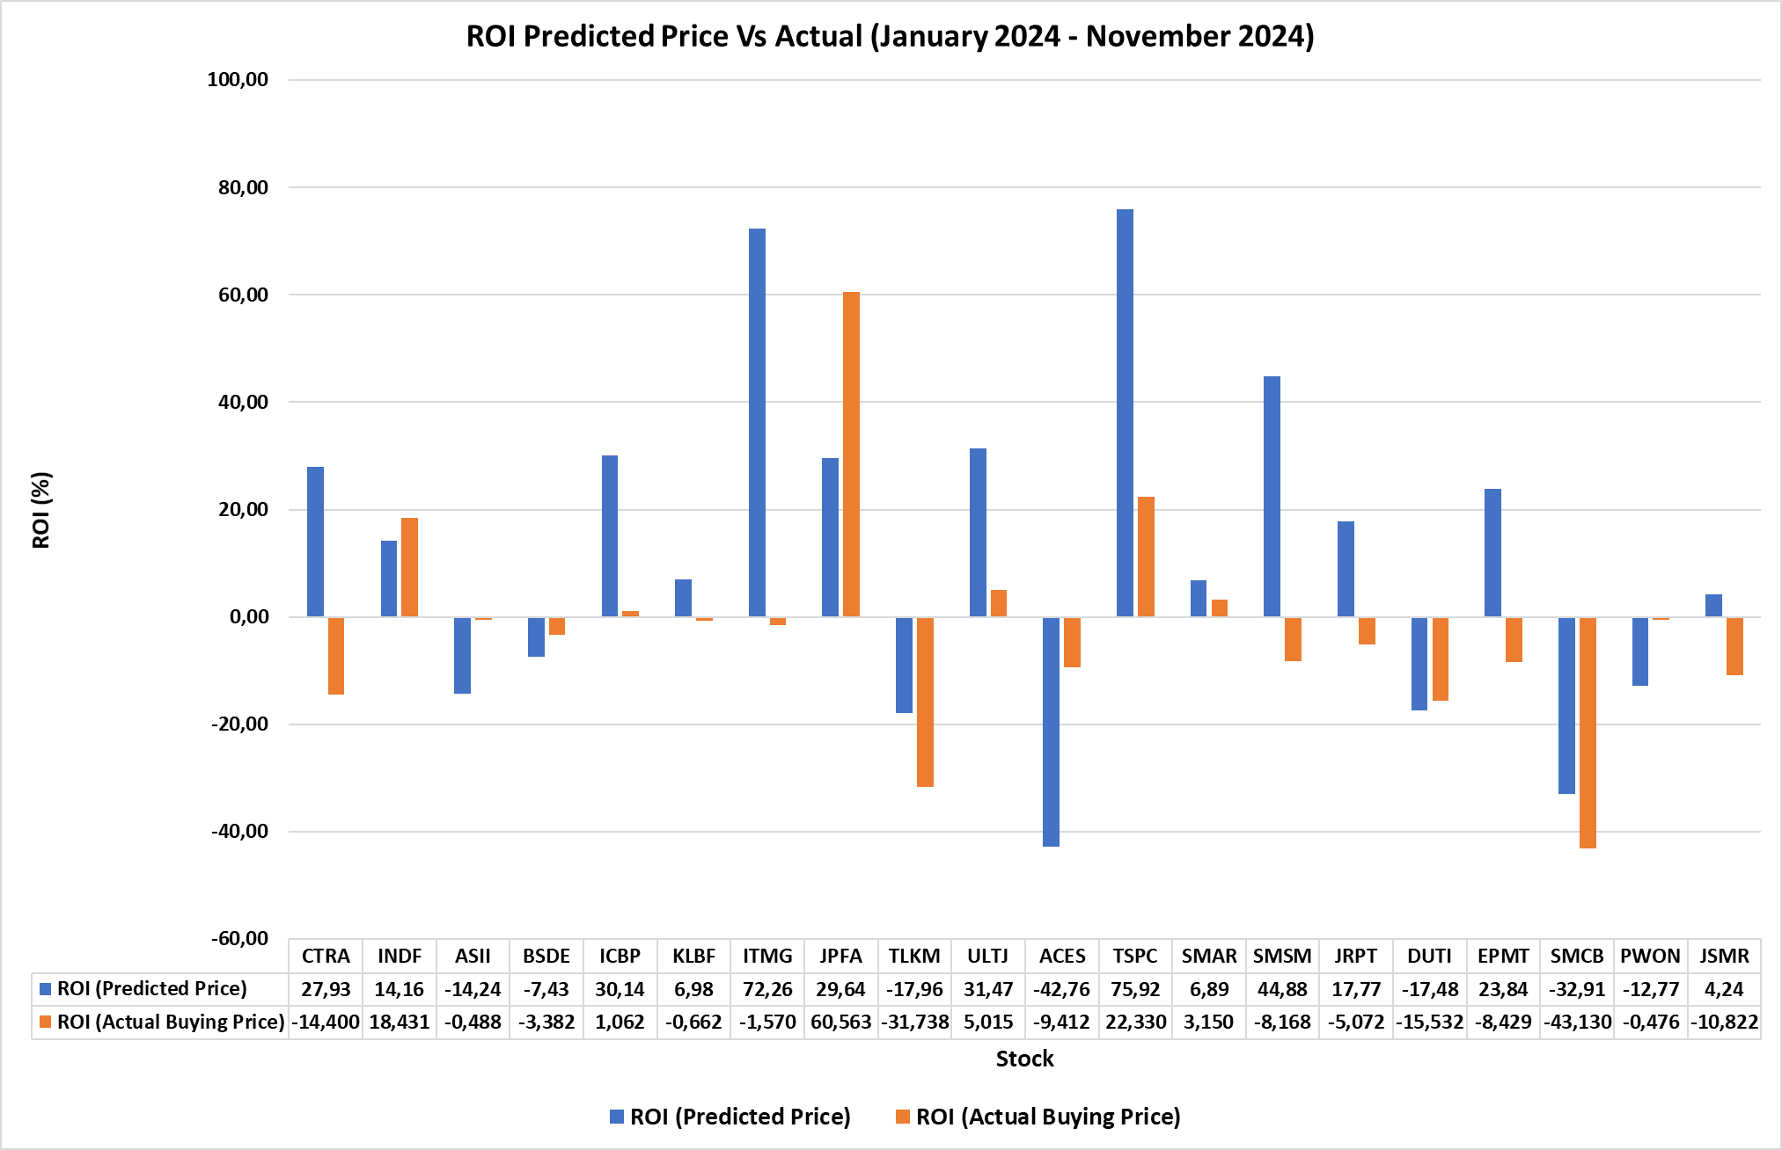
Impact Result - Return On Investment (ROI)

Slide 45
Documentation

Slide 46

Documentation
Scan Here
https://github.com/StockPredBangkit22024

Slide 47
Plan a local deployment on your project

Slide 48
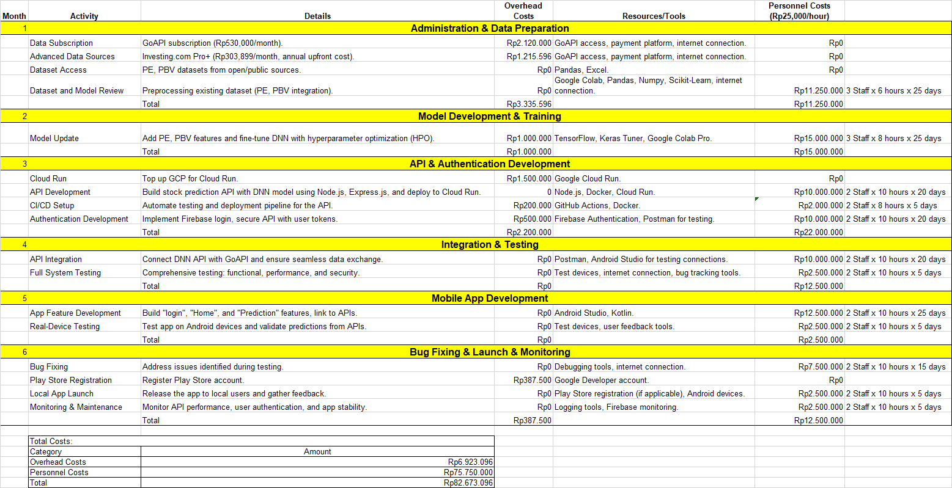
Plan a local deployment
on your project

Slide 49


C242-PS012
Thank You
For your Attention

